Slide 1


Pandemic in the Twenty First Century: How Technology and Emerging Laws are Helping/Hindering Patients' Recovery
The Good, The Bad and the Ugly
Monday, May 11, 2020
from 3:30 PM to 4:30 PM CEST
#UIACapsules
www.uianet.org

Slide 2
www.uianet.org
#UIACapsules
Bringing together the world’s lawyers
UIA is the global and multicultural organisation for the legal profession, established in 1927 and now with members in 110 countries. UIA facilitates professional development and international exchange of information and ideas, promotes the rule of law, defends the independence and freedom of lawyers worldwide, and emphasizes friendship, collegiality and networking among members.
Join the world’s largest international network of lawyers!

Slide 3
www.uianet.org
#UIACapsules
Speakers
• Joshua R. COHEN
DeCorato, Cohen Sheehan & Federico LLP, New York, NY, USA
• Shigeki TAKAHASHI, MD., Ph.D
Hamani-Takahashi Law Offices, Tokyo, Japan
• Lawrence FRIEDMAN,M.D.
UCSD School of Medicine, San Diego, CA, USA
• Diego SALUZZO
Grande Stevens Studio Legale, Turin, Italy
Moderator: Janice MULLIGAN
Mulligan, Banham, Finley California USA

Slide 4
Joshua R. COHEN
DeCorato, Cohen Sheehan & Federico LLP
NY NY, USA

Slide 5
Telehealth
“Tele”
Greek for Far/Distant
  Telegraph
  Television
  Telephone
Communicate
  TeleConnect

Slide 6
HOW TO SAFELY COMMUNICATE TODAY
Digitally – by 0’s and 1’s
  01001010 01101111 01110011 01010011 = JOSH
Slow the Viral Spread.
  SARS-CoV-2
  COVID-19

Slide 7
CONNECT WITH THOSE WHO HELP US
Platform
  Safe
  Private
  Secure
Trust
  We need our physicians and health care providers.

Slide 8
CONNECT WITH THOSE WHO HELP US
Licensing Issues
  Borders and Boundaries.
    Borders are lines on a map.
    Boundaries are moral.
    Honor Thy Neighbor.
      We are all in this together
Immunity
  Physical and Legal.

Slide 9
CONNECT WITH THOSE WHO HELP US
Reimbursement
  Insurance For Telehealth in the U.S.
  How Are We Going To Pay For This?

Slide 10
MOVING FORWARD
Increase Use of Telehealth
  An Apple a Day.
    Not True.
  Don’t Want to Keep The Doctor Away.
    Need Them Now.
Keep Them and Us Safe.
  Physically and Legally.
  Telehealth for many things but see a Doctor when you need to.

Slide 11
MOVING FORWARD
TeleCare
TeleSafe
TeleWell

Slide 12
Shigeki TAKAHASHI, MD., Ph.D
Hamani-Takahashi Law Offices, Tokyo, Japan
Notes:
DR. Friedman

Slide 13
JAPAN as A Conundrum
Shigeki TAKAHASHI
１．Why are the numbers of infections so small?
２．Why didn’t we have a lockdown?
３．Why are we afraid of overwhelming the hospitals despite having plenty of beds?

Slide 14
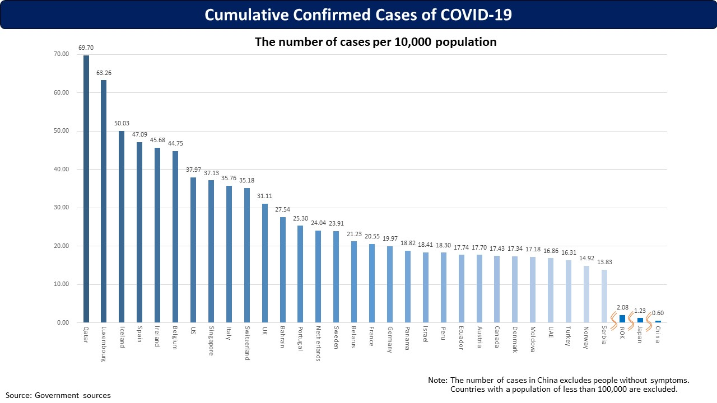

Slide 15
Number of PCR test
Population of Japan 126,440,000
Number of PCR performed 205,631
(including the second, third test to judge the condition of discharge from hospitals)
Per 1,000 population= 1.8
(USA20.6, Italy35.0, Spain28.9, Kore12.3)
(May 9, 2020)

Slide 16
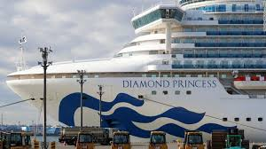
the battle against COVID began on April 3
A cruise ship named Diamond Princess docked at Tokyo Harbor.
There were 3,711 passengers and crew
Among them 712 persons had COVID.

Slide 17
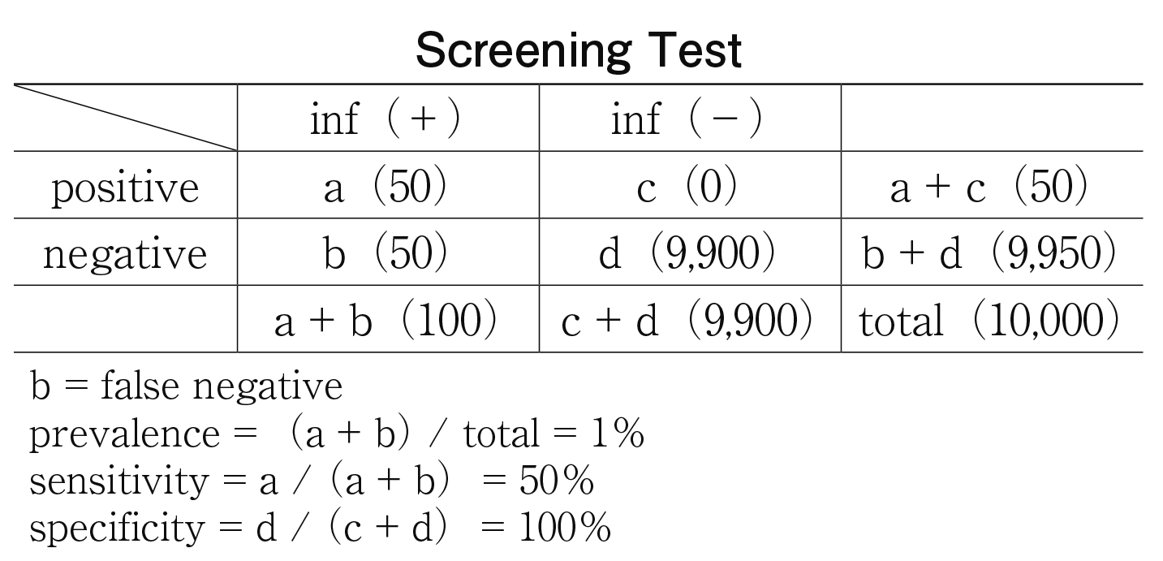
Screening TESt
Sensitivity =the proportion of actual positives that are correctly identified
Specificity=the proportion of actual negatives that are correctly identified
If we diagnose that the subject is not infected, there is actually a 50% chance that they are infected.

Slide 18
Why is the Infected number so small?
The sensitivity of the PCR test is not high (40-60%), inevitably leading to a lot of false negative cases.
We only carry out a PCR test when physicians decide it is necessary.
We only had an administrative route through local public health centers until recently.
However, as the number of suspected infections has increased, we have been confronted with the severe lack of material and human resources.
We can estimate neither the infected number nor the effective reproduction number.

Slide 19
Why not lockdown?
We have the Act on Special Measures for Pandemic Influenza and New Infectious Diseases Preparedness and Response.
The Prime Minister has the authority to declare a state of emergency.
Under this state, each Governor has the authority to demand the cooperation necessary to citizens, such as avoiding unnecessary outings, and to demand limiting the use of facilities to managers.
They are only demand, which are not enforceable.
The Government target was to reduce the person-to-person contact by 80%, and it was reduced by about 70% by citizens’ voluntary cooperation.
Almost all facilities’ managers complied with this demand.

Slide 20
Number of COVID Deaths and Death rate
/100,000
[ May 7, 2020]
 | Nubmer | Rate
USA | 73,418 | 23.1
UK | 30,076 | 46.1
Italy | 29,684 | 49.6
Spain | 25,857 | 55.8
France | 25,809 | 38.8
China | 4,633 | 0.3
Japan | 603 | 0.4
Korea | 256 | 0.5

Slide 21
overwhelming hospitals?

Slide 22
Characteristics in Japan
80% of medical institutions are small local private sectors.
They organized a political pressure group named Japan Medical Association, which has strong political power.
We do not have clear discrimination between beds for acute care and chronic care.
Small local private sectors have a lot of beds for acute care, but the reality is that the chronic stage patients are hospitalized.
They are reluctant to implement telemedicine as it expands the range of medical institutions that patients can choose.
Following the COVID pandemic, telemedicine has been approved only under several strict conditions.

Slide 23
Lawrence FRIEDMAN,M.D..
Professor of Medicine
Associate Dean for Clinical Affairs
University of California, San Diego Health System and School of Medicine

Slide 24
The Good
Research
  Will result in new vaccines and treatments
  Success may spill over to breakthroughs in cancer and other virally mediated diseases.
Public Health
  Regionally Effective and can Work
  New Zealand is a great example---takes political will
Medical
  Incredible Acts of Valore and Dedication
  Internet allows instance sharing of new medical knowledge
  New Technology and new applications
    Mobile devices, application of Artificial Intelligence
    Contact Tracing
    Rapid deployment of Telemedicine (TM)

Slide 25
TM Catalysts (Motivations)
Main Motivation: Policy not Technology
Medicare
  Waiver to Pay for TM
  Waiver to Pay for Telephone
  Waiver to cross state lines
  These are waiver, not laws
    Not clear what will remain post-COVID
Social Distancing
  Patients and Doctors Understand the Need and Find it works well
    Pick the right circumstance and patients
Not So Much New Technology But New and Broader Applications

Slide 26
This includes all 6 UC Health sites (UCSF, UCD, UCSD, UCLA, UCI, and UCR)
The result has been an exponential increase in the number of telehealth visits conducted by the University of California health systems. The vast majority of these telehealth encounters have been by converting traditional in person appointments to telehealth. This has created remarkable access to medical expertise during this difficult time, while protecting patients and clinicians from exposure to COVID-19, therefore also saving PPE for the health system.

Slide 27
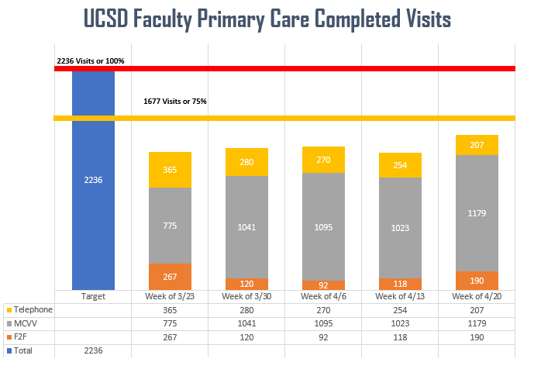

Slide 28
The Bad
Research
  Lots of competition but questionable collaboration
  Propagation of False Claims about unproven treatments
Public Health
  Public Health Departments Caught Under Funded and Unprepared
  Decisions Often Political and Not Public Health Supported
Medical
  Work force sometime afraid to go to work and often way understaffed/sick
  Professionals forced to provide care when they are not experienced or fully trained
  Lack of Equipment and Proper Space in Some Locations
  Huge Financial Strain on the Health system

Slide 29
The Ugly
Political
  Lack of Trust, Accountability and Competency
  Not Bringing the US Together As One Might Expect
  Lack of Central Planning or Organized Coherent Response
  States Making Decisions without Federal Principles or Guidelines
Public Health
  Chaos in Some Regions including Nationally
  Lack of Testing, Tracking and Protective Gear
Medical
  Loss of Jobs Means Loss of Insurance
  Many patients will defer needed tests. Happened in 2008, expect worse this time
  Hospitals and medical offices will go out of business
  People Afraid to go to Hospitals and Emergency rooms
    Heart Attacks and Strokes at Home

Slide 30
What (HOPEFULLY) the Future Will Bring
Return to Trusting Government and Public Health
  History will Judge the US Response Harshly
Return of Globalization
  We are all connected
New Debate Over Insurance Coverage for All
Widespread adoption of Telemedicine and Remote Monitoring
  Advanced Patient-Centered Care virtually
New Knowledge of Viruses, Prevention and Treatment
Role of Federal vs State and Local Public Health Decision-making
We Will be Drinking Wine rather than Bleach

Slide 31
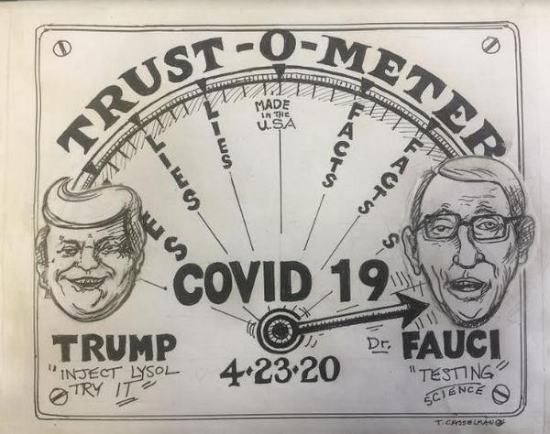

Slide 32
Visit our website:
health.ucsd.edu

Slide 33
Diego SALUZZO
Grande Stevens Studio Legale Turin, Italy

Slide 34
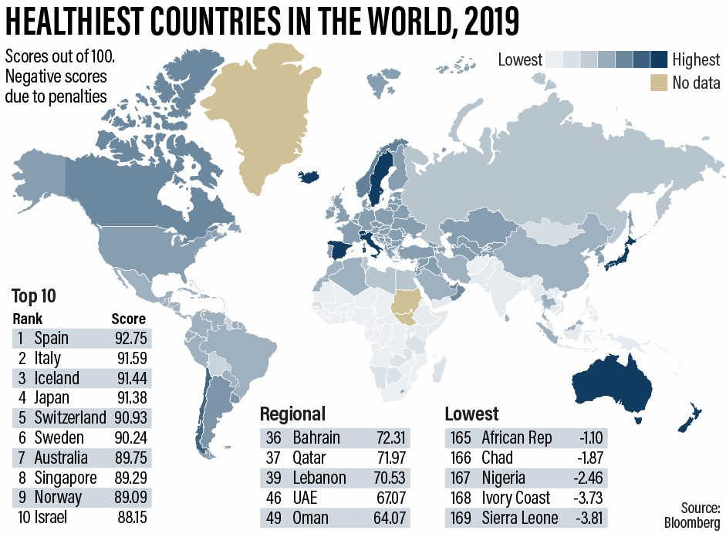
We were supposed to be very good …

Slide 35
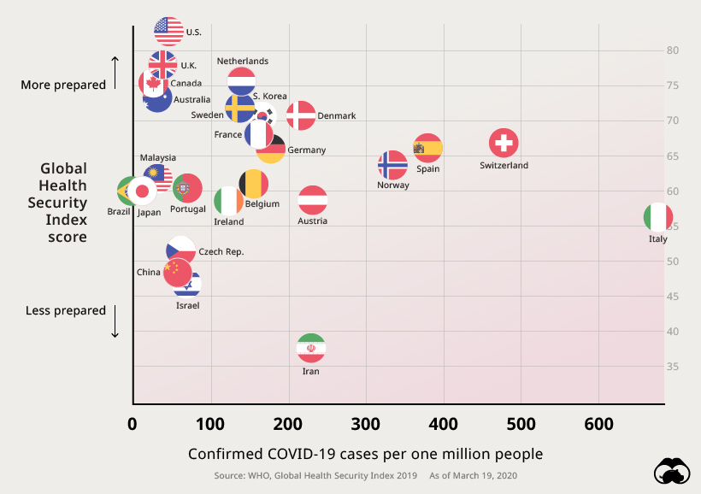
… we are realizing to have been the worst

Slide 36

Reasons for an announced failure: The Bad
Late reply: unable to contain Covid-19 in its infancy
No use of Chinese experience for preparing and educating health system
Pandemic of fake news / Negationist approach of politicians
From zero attention to experts to proliferation of experts
Public Health System weaknesses: stress test failed
Poor support by territorial health system
Fangang hospitals “Italian style” and realized too late
Invasion of hospitals and intensive care units
Lack of resources: protection systems and ventilators
Nursing homes / religious communities
Lack of civil sense: massive exodus from North to South
Unproper communication: security measures via social/TV
Emergency legislation: the triumph of bureaucracy
1 Country, 20 regions and 7904 Municipalities

Slide 37
The Ugly
Deceased: 30,395 / 156 Doctors
* as of May9, 2020
A virus deadly more for democracies that do not like neither curfew nor telecontrol via drones, apps and mobile telephone traffic
A virus deathly more for the health organizations, that need to be reorganized completely, than for the individuals
Shortage of resources and constant state of emergency imply standardized medical practice (pre-triage/triage/allocation of critical care beds…)
No room for considering differences between humans, that are at the very basis of Medicine in the XXI Century and of individual freedom.
There is an exacerbation of social classes, age, culture differences in the possibility to afford the cure and the care due to pandemic consequences
Comparison with the other two “Super Old” Countries

Slide 38

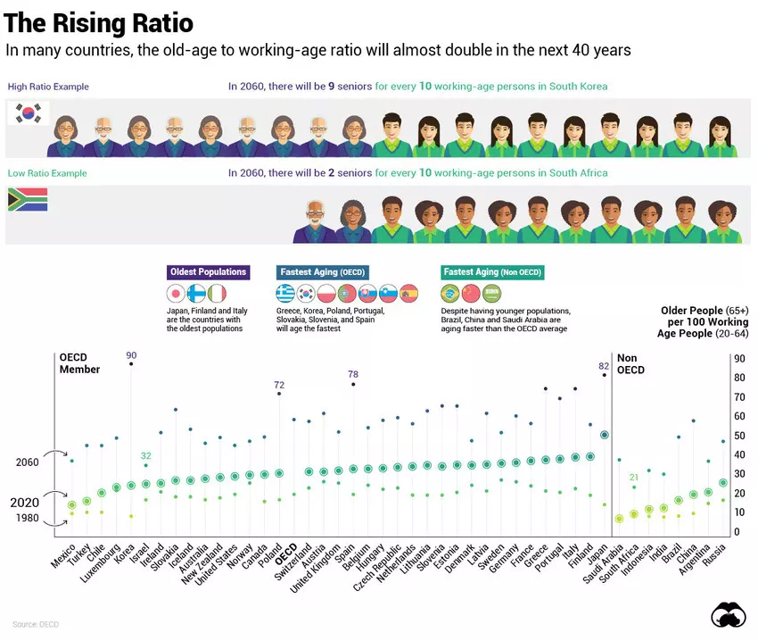

Slide 39

SIAARTI
As of March 6, 2020, the Italian Society of Anesthesia, Analgesia, Resuscitation and Intensive Care (SIAARTI) issued recommendations and relevant ethical considerations to better inform the clinicians involved in the care of critically-ill COVID-19 patients, in a setting where a disproportionate number of patients requiring life-sustaining treatments was rapidly saturating both the existing and the newly set-up ICU beds. (Vergano et al. Critical Care (2020) 24:165)
Criteria for ICU admission for fair distribution of resources in shortage of resources in intensive care units, having regard to factors like biological age, concomitant diseases, severity and prognosis of current critical condition and predictable quality of life. The “first come, first served” criterion for ICU admission does not necessarily have to be followed.

Slide 40
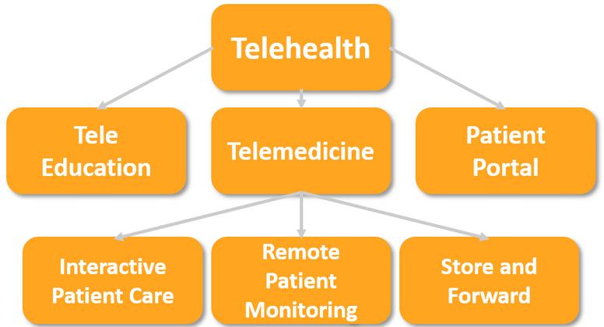
The Good
Complex systems benefit from shocks
A new era of connected care and telehealth
The wisdom of who invested in advance
A reformed health system as guarantor of economic resurrection

Slide 41
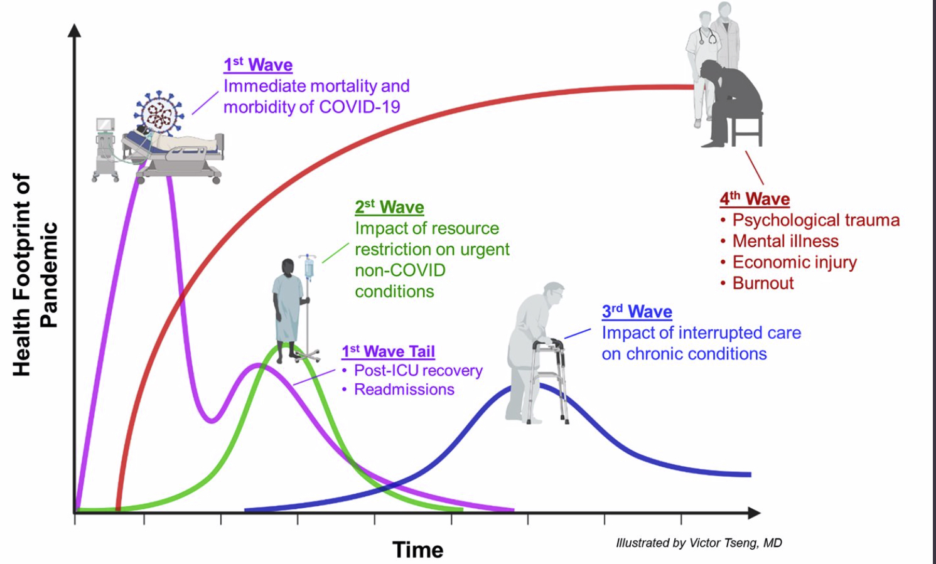
The Good in facing Covid-19 pandemic
Fear of contagion as aggregating factor
Telehealth, born to abolish distance, keep distances
Telemedicine cancels space and changes the time
Telehealth change the assistance and care model and health systems business model

Slide 42
The Good: how to forecast the future
Need of decentralized structures, but maintaining the patient at the cente
Telehealth, born to abolish distance, keep distances
Telemedicine cancels space and changes the time
Telehealth change the assistance and care model and health systems business model
1. Prevention:
Life styles
2. Access online:
tele-consultation AI, self diagnosis
chatbot
Connected Care
3. Care: avoid contagion, fast diagnosis, patients isolated, robots
4. Follow up
Cronic patients
Medical check-up

Slide 43
Pandemic in the Twenty First Century: How Technology and Emerging Laws are Helping/Hindering Patients' Recovery
Q&A
#UIACapsules
www.uianet.org

Slide 44
Pandemic in the Twenty First Century: How Technology and Emerging Laws are Helping/Hindering Patients' Recovery
The Good, The Bad and the Ugly
Monday, May 11, 2020
from 3:30 PM to 4:30 PM CEST
#UIACapsules
www.uianet.org

